Slide 1
Welcome to CS 111

Slide 2
Course Websites
Canvas (now at canvas.Humboldt.edu) is the central hub for the course
Github (https://github.com/acarteas/Teaching-CSFoundations1) will be used to store all course materials: course syllabus, official calendar, assignment descriptions, and other course documents

Slide 3
The required textbook is free!
Find the book on course Github

Slide 4

Other Recommended Reading

Slide 5
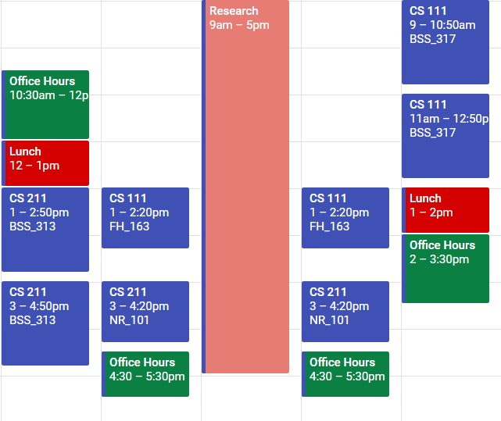
Adam’s Schedule

Slide 6
Programming Environments
Use whatever you want!
For JavaScript, I use Visual Studio Code (free, available on all platforms)
For C++, I use Visual Studio 2017 (free, Windows only).
If you don’t have Windows, I would use:
JetBrains CLion (MacOS)
Xcode (MacOS)
NetBeans IDE (all platforms)
If you need help getting your computer set up, let me know.
BSS 313 has everything you need installed. Our lab does not ☹
You can connect through vlab.Humboldt.edu from any machine connected to the Internet and have access to the full development suite.

Slide 7
Homework Policy
All homework must be submitted by the due date; NO LATE TURN-INS!

Slide 8
A Note on Cheating
Don't do it!
See syllabus for examples of cheating.

Slide 9
Grade breakdown
Participation (5%)
Programming assignments, homework, and micro assignments (40%)
Labs (10%)
Two midterm exams (10% / ea)
Final exam (25%)

Slide 10
Final grade translations
93.00 – 100.00 | A | 71.00 – 75.99 | C
90.00 – 92.99 | A- | 69.00 – 70.99 | C-
87.00 – 89.99 | B+
82.00 – 86.99 | B | 60.00 – 68.99 | D
78.00 – 81.99 | B- | 00.00 – 59.99 | F
76.00 – 77.99 | C+

